Slide 1
A Tensorized Transformer for Language Modeling
Xindian Ma, Peng Zhang, Shuai Zhang, Nan Duan, Yuexian Hou, Dawei Song, Ming Zhou
NeurIPS 2019
Reporter: LuShuai

Slide 2
Overview
In Transformer, the multi-head attention is a key part and it is constructed by a large number of parameters.
Contributions:
1) It is proved that the output of scaled dot-product attention can be linearly represented by a group of orthonormal base vectors.
2) A novel self-attention method, namely Multi-linear attention, is provided, which combines two compression ideas, parameters sharing and low-rank approximation, together.
3) We also prove our model can reconstruct the scaled dot-product attention in the original Transformer.
Notes:
压缩的困难:softmax

Slide 3


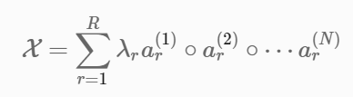


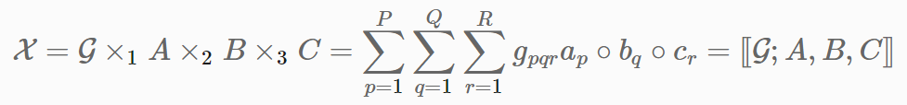


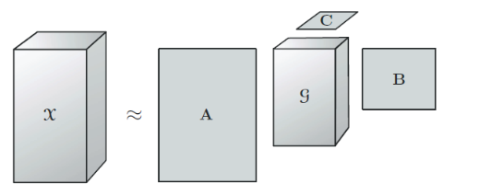
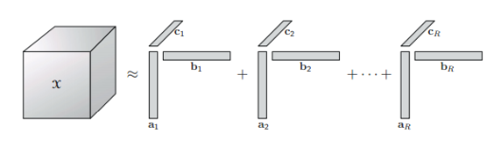
Background
Block-Term Tensor Decomposition
CP decomposition
Tucker decomposition
Notes:
将一个N阶的张量分解为R个秩为1的张量和的形式 三个因子矩阵和一个核张量

Slide 4

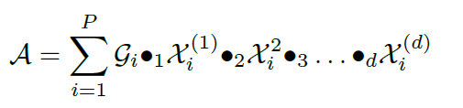
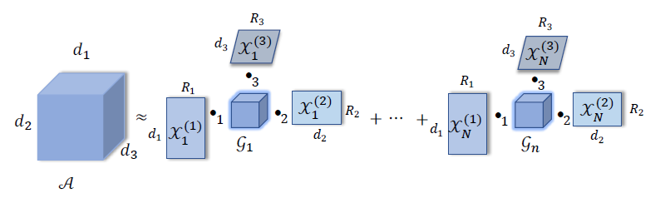
Background
Block-Term Tensor Decomposition
Block-Term tensor decomposition is a combination of CP decomposition and Tucker decomposition.

Slide 5

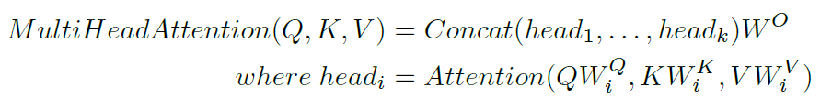
Background
Multi-head Attention

Slide 6
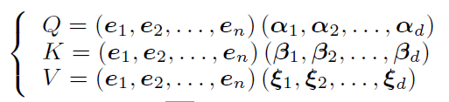

Tensorized Transformer
Single-block Attention by Tucker Decomposition
First, we consider that the self-attention function can be linearly represented by a set of orthogonal basis vectors, when the input of softmax function is the product of two coefficient matrices.
Second, in constructing the multi-head mechanism, the matrices of basis vectors can be shared.
Notes:
为了后面的参数共享做准备

Slide 7
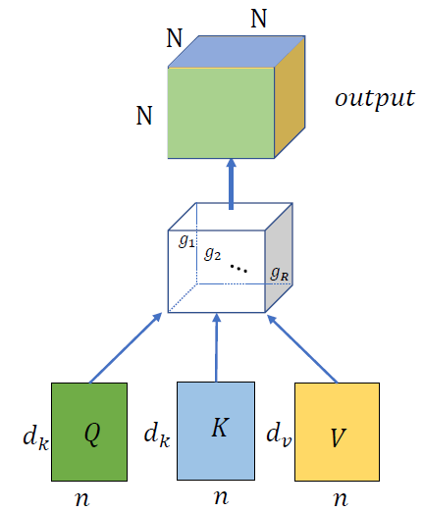
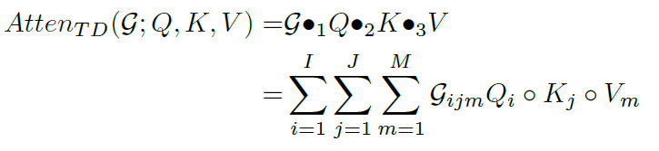

Tensorized Transformer
Single-block Attention by Tucker Decomposition
We assume that the query, key and value can be mapped into three factor matrices of which are composed of three groups of orthogonal basis vectors. Three factor matrices are Q, K and V.
Notes:
反过来的过程 因子矩阵QKV 可训练的对角张量G 三阶张量和原本输出二阶矩阵的关系

Slide 8


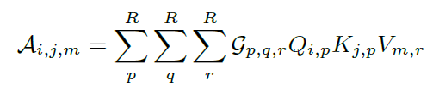
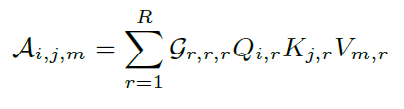
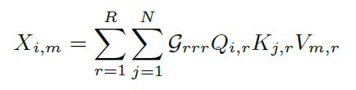
Tensorized Transformer
Single-block Attention by Tucker Decomposition

Slide 9
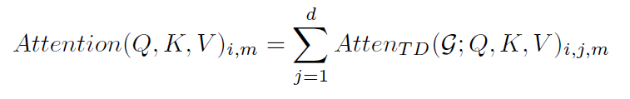
Tensorized Transformer
Single-block Attention by Tucker Decomposition
In our model, we do not adopt the above reconstructing process. Instead, to obtain a new representation, we adopt the concat method after the tensor splitting.

Slide 10
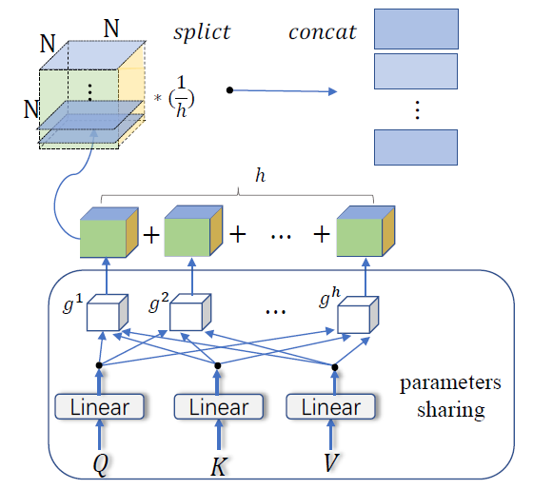
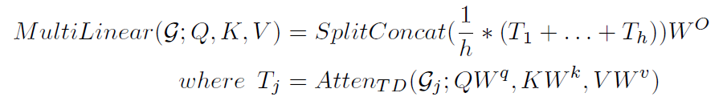
Tensorized Transformer
Multi-Linear Attention by Block-Term Tensor Decomposition
The learned linear projection can map queries, keys and values to three matrices which are composed of basis vectors.
Notes:
W共享

Slide 11
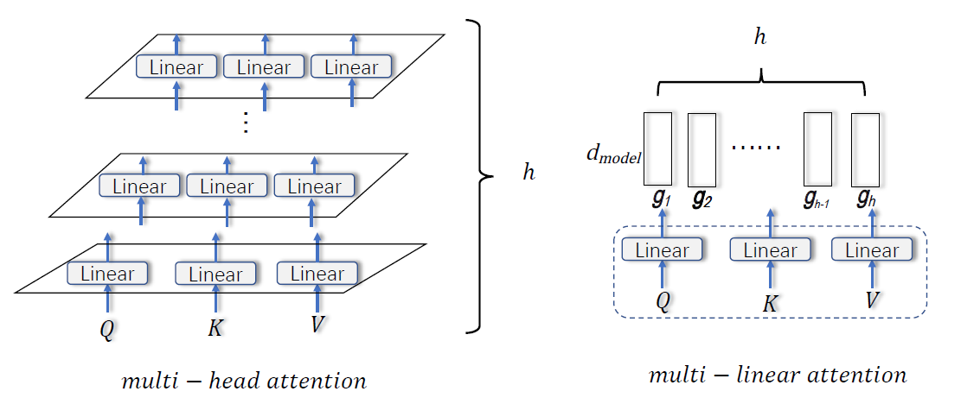
Tensorized Transformer
Multi-Linear Attention by Block-Term Tensor Decomposition
Notes:
W共享

Slide 12
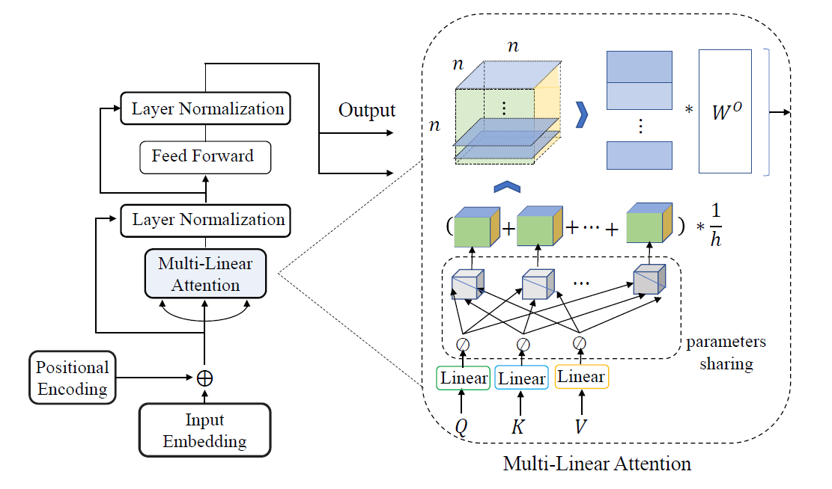
Tensorized Transformer

Slide 13
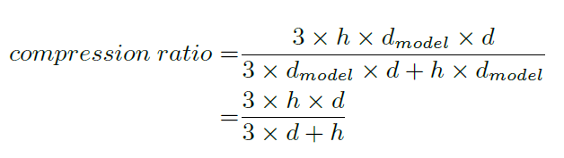


Tensorized Transformer
Analysis of Compression and Complexity

Slide 14


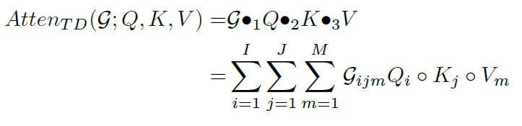

Tensorized Transformer
Analysis of Compression and Complexity

Slide 15
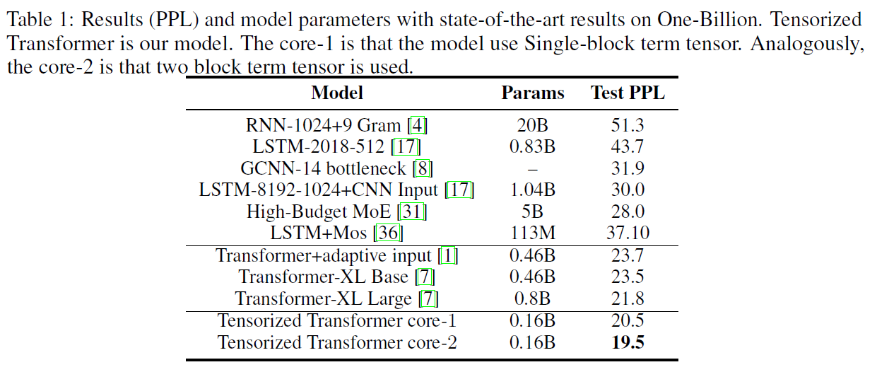
Experiments
Language Modeling
Notes:
Core-h is the number of core tensors

Slide 16
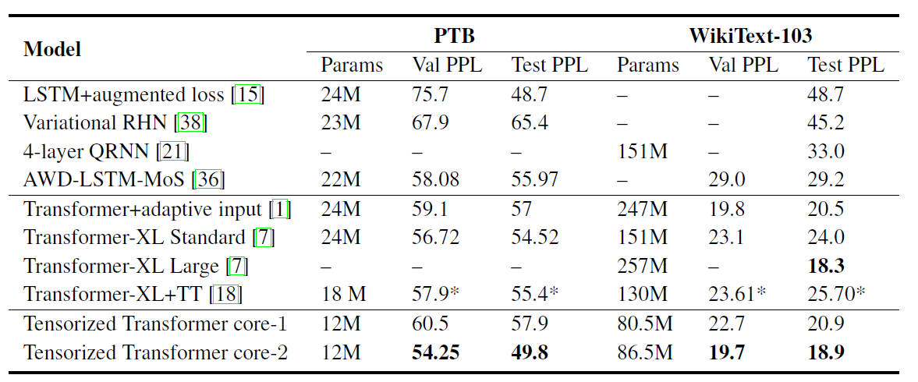
Experiments
Language Modeling
Notes:
TT: Tensorized embedding layers for efficient model compression

Slide 17
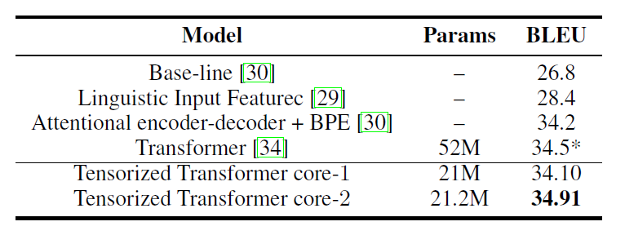
Experiments
Neural Machine Translation

